Slide 1

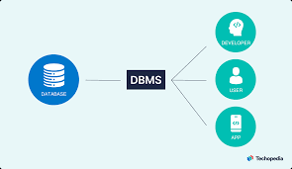

Introduction to Databases
Joseph Fathallah
*_*

Slide 2
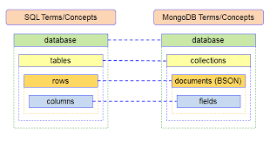
(Introduction) MongoDB vs SQL - A Comparative Analysis
Briefly introduce the topic and mention that we will compare MongoDB (a NoSQL database) and SQL (a relational database) in this presentation.
Mention the objective: to understand the differences and functionalities of each type.

Slide 3
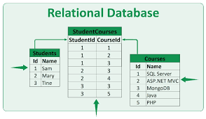
(Overview) SQL - A Relational Database
Introduce SQL as a relational database management system (RDBMS).
Key points:
Tabular storage model (tables with rows and columns).
ACID properties (Atomicity, Consistency, Isolation, Durability).
Strong data integrity and relational integrity support.

Slide 4
(Functionality Comparison) Functionality Comparison: MongoDB vs. SQL
Present a
table
comparing
Various
functionalities
of both databases.
Functionality | MongoDB (NoSQL) | MongoDB (NoSQL)
Data Model | Document-oriented (BSON format) | Document-oriented (BSON format)
Schema | Dynamic schema (no rigid structure) | Fixed schema (defined structure)
Query Language | JSON-based queries (NoSQL Query Language) | SQL queries
Scalability | Horizontal scaling (sharding) | Vertical scaling (adding resources)
Transactions Support | Limited support (single-document level) | Strong support (ACID transactions)

Slide 5
(Use Cases) Use Cases for MongoDB and SQL
Highlight specific scenarios where each database excels.
Use Cases for MongoDB:
Unstructured data: Storing and managing data with varying structures, such as user-generated content, social media feeds, and product catalogs.
Real-time analytics: Handling high volumes of rapidly changing data, like time-series data and IoT sensor readings.
Agile development: When flexibility is essential, and schema changes are frequent.
Use Cases for SQL:
Complex transactions: Applications requiring multi-row, multi-table operations with data integrity, such as financial systems and e-commerce platforms.
Data integrity critical: Use cases that demand strict enforcement of data integrity constraints, like banking and healthcare systems.
Business intelligence: Analyzing and reporting on structured data from multiple related tables, common in business reporting and decision-making.

Slide 6

(Conclusion) Conclusion
Summarize the main points from the comparison.
Mention that the choice between MongoDB and SQL depends on the specific requirements of the application.
Reiterate that MongoDB is suitable for unstructured data and agile development, while SQL excels in complex transactions and data integrity-critical scenarios.

Slide 7
This Is Readme
Checkpoint Objective In this checkpoint:
you are asked to prepare a presentation where you will compare NoSQL to SQL. Choose MongoDB VS SQL and make 5 slides to compare them.
Instructions :
Present each type and their functionalities. Make a comparison between them.

